Slide 1
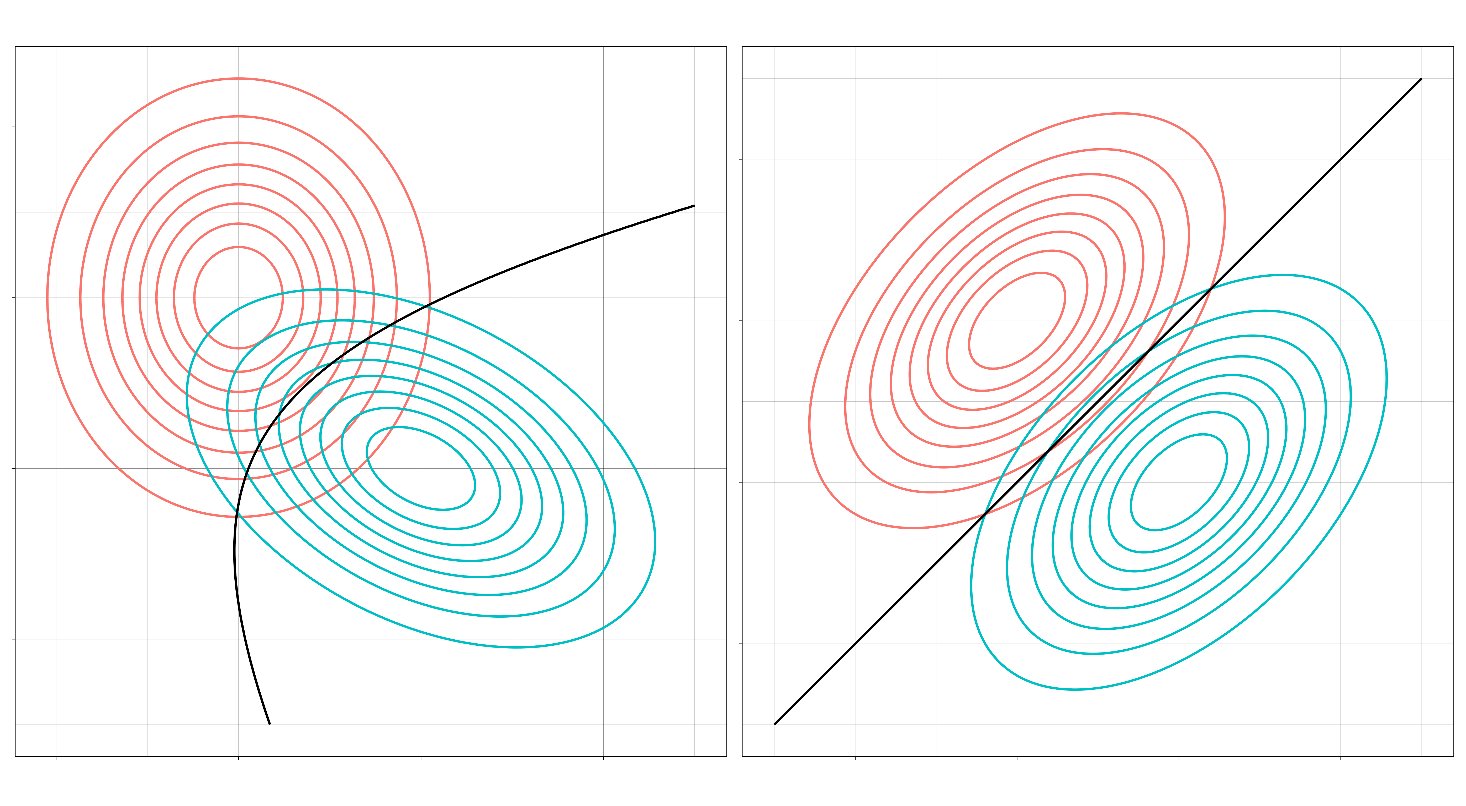
Employee Data Analysis Using Excel
STUDENT NAME:S.MUTHAMIL SELVI
REGISTERNO:122200494/asunm123122200494
DEPARTMENT:B.COM(CS) CORPORATE SECRETARYSHIP
COLLEGE:MOHAMED SATHAK COLLEGE OF ARTS AND SCIENCE

Slide 2

PROJECT TITLE
Employee Performance Analysis Using Excel

Slide 3

AGENDA
Problem Statement
Project Overview
End Users
Our Solution and Preposition
Dataset Description
Modelling Approach
Results and Discussion
Conclusion

Slide 4

PROBLEM STATMENT
Employee data analysis using Excel is a valuable tool for organizations to gain insights into workforce management, productivity, and overall organizational health. The analysis helps in making informed decisions about hiring, employee performance, retention, and resource allocation. Here are several key uses of employee data analysis with Excel:
1. HR and Workforce Management
2. Performance Management
3. Compensation and Benefits Analysis
4. Training and Development
5. Recruitment and Onboarding Analysis
6. Diversity and Inclusion
7. Forecasting and Planning
8. Visualizing Trends
9. Compliance and Legal Reporting

Slide 5

PROJECT OVERVIEW
Employee data analysis using Excel helps organizations make informed decisions about their workforce by analyzing key HR metrics. This process involves gathering and processing employee data to identify trends and patterns in performance, turnover, compensation, and other key areas.
Key uses of employee data analysis in Excel include:
Performance Management: Tracking employee KPIs, productivity, and goal achievement.
Turnover and Retention: Analyzing attrition rates, reasons for leaving, and strategies to improve retention.
Compensation Analysis: Evaluating salary trends, pay equity, bonuses, and overtime.
Recruitment Metrics: Assessing time-to-hire, cost-per-hire, and new hire performance.
Absenteeism: Monitoring patterns in employee attendance and leave.
Diversity and Inclusion: Tracking diversity across demographics such as age, gender, and ethnicity.
Training and Development: Evaluating the effectiveness of training programs and identifying skill gaps.
Key tools and techniques used:
Excel formulas (e.g., SUMIF, COUNTIF, AVERAGE, VLOOKUP).
PivotTables and Pivot Charts for data summarization.
Data visualization using charts, graphs, and dashboards.
By leveraging these techniques, companies can uncover actionable insights that improve workforce management, enhance employee satisfaction, and optimize HR operations.

Slide 6

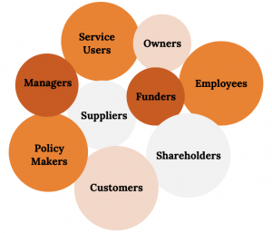
WHO ARE THE END USERS?
The end users of employee data analysis using Excel are
Human Resources (HR) Team
Senior Management and Executives
Department Heads and Line Managers
Compensation and Benefits Teams
Finance and Budgeting Teams
Diversity and Inclusion Officers
IT and Data Analysts
Consultants and External Advisors

Slide 7

OUR SOLUTION AND ITS VALUE PROPOSITION
Filtering – missing values:
Filtering in Excel helps identify and isolate missing values, allowing for quick data validation and correction.
Condition formatting- to find the missing values
Filtering – to remove the blank values
Formula – to find the performance level values in alphabetical values
In Conditional Formatting, blank values can be highlighted to easily identify empty cells for data validation or further action.
Pivot table:
A Pivot Table in Excel is a powerful tool that summarizes, analyzes, and organizes large datasets by allowing dynamic sorting, filtering, and aggregation of data.
Chart/Graph – for data visualization
A chart in Excel visually represents data, making it easier to understand trends, patterns, and comparisons through various graph types like bar, line, pie, and scatter plots.

Slide 8

Dataset Description
Employee data set- Kaggle
26 features
Feature- 9 features
Employee id
Gender-male, female
Performances
Business unit
Name
Rating- numerical

Slide 9

THE “WOW” IN OUR SOLUTION
Performance level = IFS(Z8>=5,”VERY HIGH”,Z8>=4,”HIGH”,Z8>>=3,”MED”,TRUE,”LOW”)

Slide 10

MODELLING
Data collection
First I login my Naan mudhalvan id and went to Edu-net dashboard.
From there I download “Employee data set”.
Features Collection:
Though I’m doing the Employee performance analysis I collected;
EMP-ID :For employee reference.
EMPLOYEE FIRST AND LAST NAME: For identifying their performance.
BUSINESS UNIT: To ascertain their working sector.
EMPLOYEE STATUS : To know whether there are active or future start.
EMPLOYEE TYPE: Is to find whether there are working for full time or parttime or contract.
GENDER CODE : To access their sex.
PERFORMANCE SCORE : It is calculated to judge his skills whether he/she wants to improve or not.
EMPLOYEE CURRENT RATING: This helps us to acknowledge his/her talent using these ratings.
PERFOMANCE LEVEL: This is derivate to know the rank of the employees

Slide 11

Data Cleaning Here I done two things, First I figure out missing or blank column ,then I filter those blanks. STEPS TO IDENTIFY MIISING VALUES: 1.Select the whole row which you figure it out . 2.select conditional formatting . 3.Select highlight cells rules and click more rules. 4.Choose blank from format cells and choose colours and press ok . STEPS TO REMOVE THISE BLANK USING FILTER: 1.Search for sort and filter and select filter. 2.There will be small arrow on the selected row click that and choose filter by colour. 3.Then press no fill to remove the blanks.

Slide 12

Performance level: Performance level is calculated using the data’s in the employees current rating . I DONE THROUGH THESE STEPS: Step 1: Choose the appropriate column Step 2: And type IFS formula to calculated all. Step 3: Type equal to and select the row and enter >= number….. Step 4: Finally type “TRUE”,”LOW” and press entre to get results.

Slide 13

Summary of Pivot table: I PREPARE THE PIVOT TABLE FORM THE FOLLOWING MANNER: First, I consider “BUSINESS UNIT” as my rows. Secondly, I drag the “PERFORMANCE LEVEL” in column. Next, I drop “GENDER CODE” in filter If we want a specific data use “slicer” I choose “EMPLOYEE STATUS” using slicer. Visualization: The process of showing data in pictorial form is called visualization. I done through few steps: Go to insert and select recommended chart. Select the chart which ever you like and click ok. Add title by pressing the pressing the plus symbol on the top corner of the chart. Add trend lines like the previous step.

Slide 14
RESULTS

Slide 15
RESULTS

Slide 16
CONCLUSION
In the pivot chart/graph medium level has shown a steady performance level. By focusing on the identified areas for improvement and leveraging available support, they can further enhance their contributions and achieve greater success.

